Slide 1
BT 601: Analytical Biotechnology
-Prof. Siddhartha Sankar Ghosh
Lec-2

Slide 2
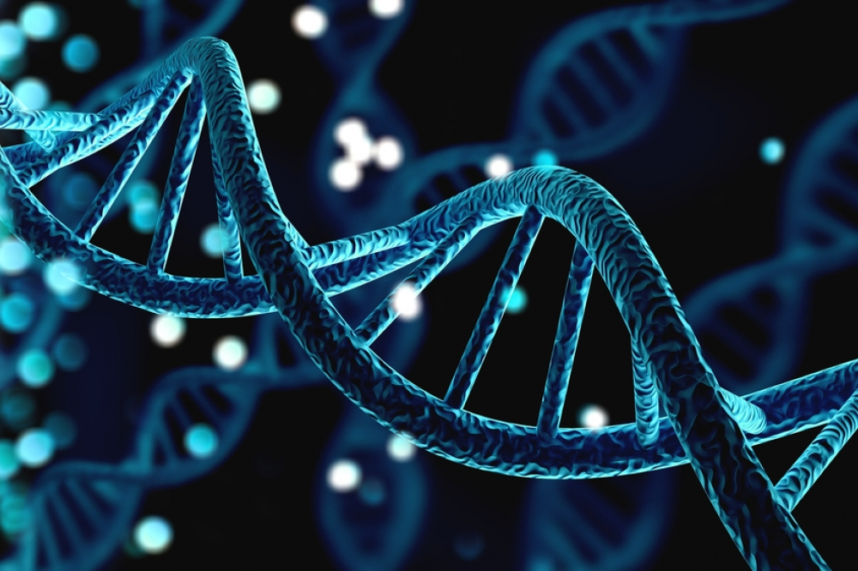
Genomics

Slide 3
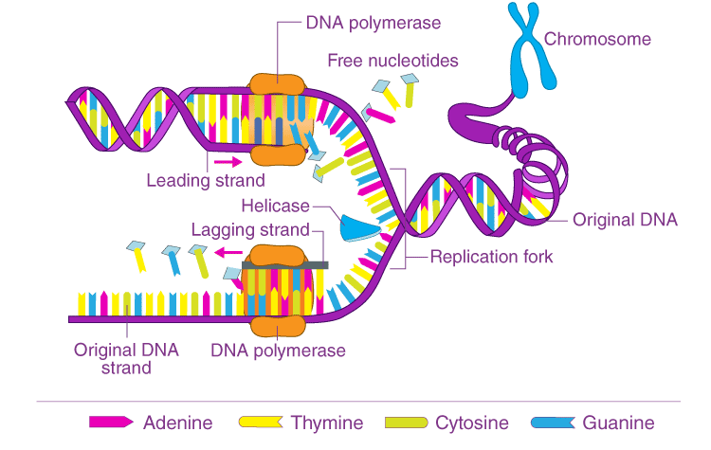
Synthesis of DNA
DNA synthesis occurs by the process of replication.
During replication, each of the two parental strands of DNA serves as a template for the synthesis of a complementary strand replication.
Each molecule generated by the replication process contains one intact parental strand and one newly synthesized strand.

Slide 4
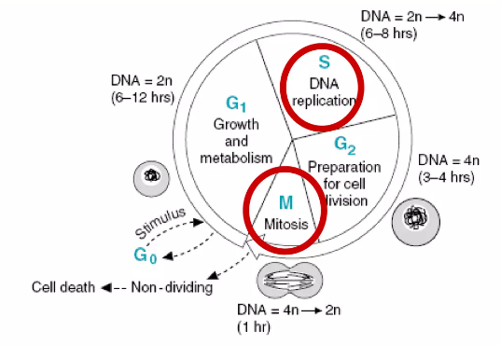
Synthesis of DNA
In Eukaryotes DNA synthesis happens in S phase of the cell cycle.
Then the cells divide in the M phase, and each daughter cell receives an exact copy of the DNA of the parent cell.

Slide 5
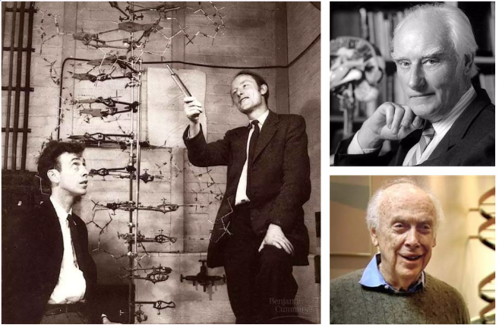
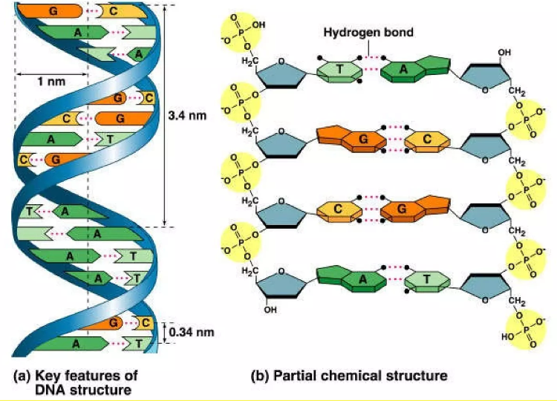
Double Helix structure of DNA
“It is not escaped our notice the specific pairing we have postulated immediately suggests a possible copying mechanism for the genetic material”
-1953 Article in Nature-Watson & Crick

Slide 6
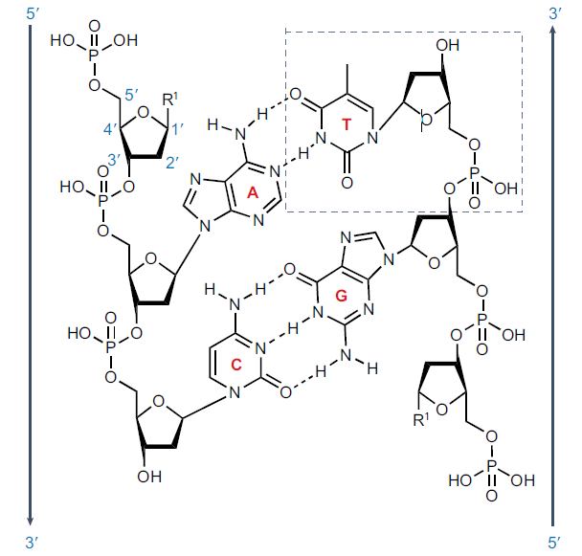
Chemical structure of DNA
DNA is a monodisperse polymer of four building blocks, each comprising a base and a sugar residue, deoxyribose.
Each block [adenosine (A), thymidine (T), guanosine (G), cytidine (C)] is coupled to a phosphate, which constitutes a nucleotide (thymidine highlighted by a dashed box).
Nucleotides joined by phosphodiester bonds form a polynucleotide chain. The bases in this polymer pair up via three hydrogen bonds between G and C and two hydrogen bonds between A and T.
Watson–Crick base pairing, enables the formation of a double helix in which two complementary strands run anti-parallel to one another and intertwine with base pairs (A–T, C–G) stacked along the helical axis. Owing to its self-complementarity, the double helix can be self-replicated from each of the two strands. Arrows indicate the 5ʹ-to-3ʹ direction of the asymmetric ends.

Slide 7
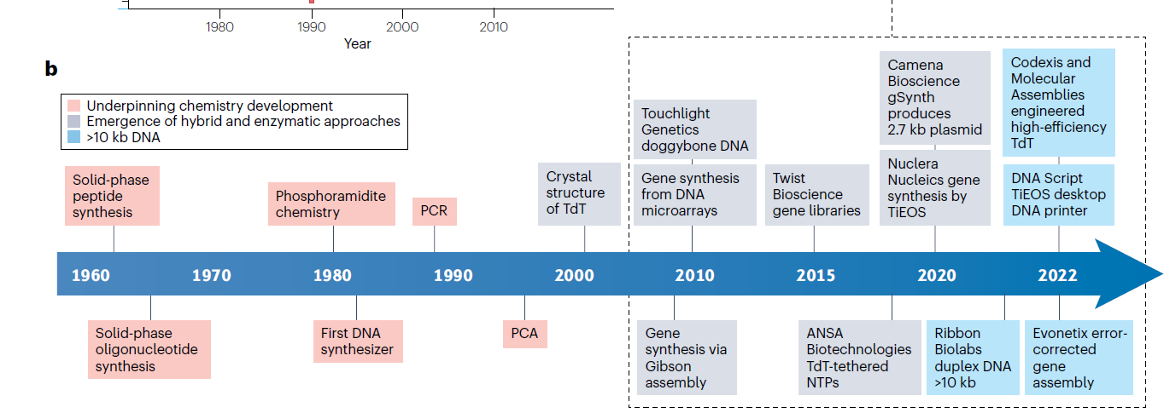
Timeline of milestones in DNA synthesis technologies

Slide 8
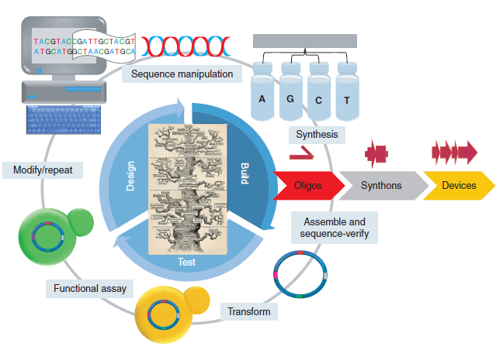
Synthetic DNA Technology
Synthetic DNA constructs are designed and manipulated using computer-aided design software.
The designed DNA is then divided into synthesizable pieces (synthons) up to 1–1.5 kbp.
The synthons are then broken up into overlapping single-stranded oligonucleotide sequences and chemically synthesized.
The oligonucleotides are then assembled together into the designed synthons using gene synthesis techniques. If necessary, multiple synthons can be assembled together into larger DNA assemblies or devices.
The assembled DNAs are then typically cloned into an expression vector and sequence-verified. Once verified, the synthetic constructs are transformed into a cell and the function of the synthetic construct is assayed.
Depending on the results the constructs can then be modified or refined and the test cycle is repeated until a DNA construct is obtained that produces the desired function.

Slide 9
Single-Stranded DNA Synthesis
Chemical Synthesis Chemical synthesis is a method to generate ssDNA without a template. Single-stranded DNA fragments smaller than 200 nt are mainly produced by chemical synthesis, such as-
Column-based oligo synthesis
Microarray synthesis

Slide 10
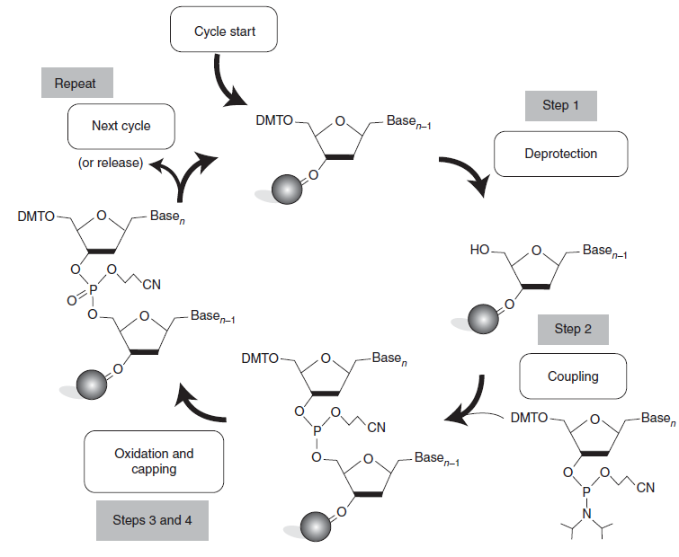
Column-based oligo synthesis
In the early 1980s, the solid-phase phosphoramidite method and automatic instruments significantly improved the stability and accuracy of oligonucleotide synthesis and can be used in commercial production.
The standard column-based synthesis is a cyclical process, in which the nucleotide chain is extended between the 3′-end and 5′-end, including four processes: deprotection, coupling, blocking, and oxidation.
Phosphoramidite-based synthesis of oligonucleotides

Slide 11
Microarray synthesis
The yield of oligonucleotide synthesis based on microarrays is usually within the fmol scale, which is two to four orders of magnitude lower than the traditional column synthesis. This low synthesis scale leads to the reduction of the amount of required reagents for synthesis.
In addition, each chip has a synthesis density of tens of thousands, which reduces the cost of synthesis per base by a factor of 100-5000 compared to column synthesis
In addition to the reduced synthesis scale, chip-based oligonucleotide synthesizers offer levels of multiplexing not possible on traditional column-based synthesizers that allow for a greater number of unique oligonucleotide sequences to be synthesized in a given synthesis run.

Slide 12
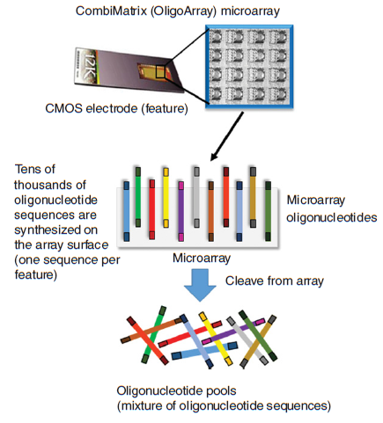
Microarray synthesis
Microarray-based oligonucleotide synthesis-
In this method, microarray chips containing tens of thousands of distinct features synthesize unique oligonucleotide sequences at once with one unique oligonucleotide sequence synthesized per chip feature.
On standard arrays, there are no physical barriers between features, so following cleavage of the synthesized oligonucleotides from the chip surface the end product is a pool of sequences containing every oligonucleotide synthesized on the array.
Subsequent processing steps are required to “fish” the desired oligonucleotide sequences out of the synthesis pool for subsequent gene synthesis.

Slide 13
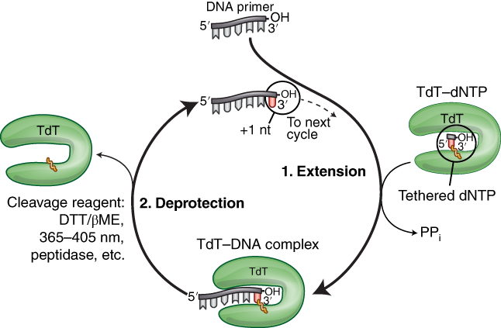
Enzymatic synthesis
ssDNA Synthesis Based on Terminal Deoxynucleotidyl Transferase (TDT)-
Terminal deoxynucleotidyl transferase (TDT) is a polymerase with low specificity for nucleotide substrates and does not rely on templates.
Deoxynucleotidyl triphosphates (dNTPs) can be added to the 3’end of ssDNA without selection. It is a relatively cheap and rapid method to synthesize ssDNA.
A major challenge in TDT synthesis is to control the addition of a single base, because TDT enzymes tend to catalyze the addition of multiple bases per cycle.

Slide 14
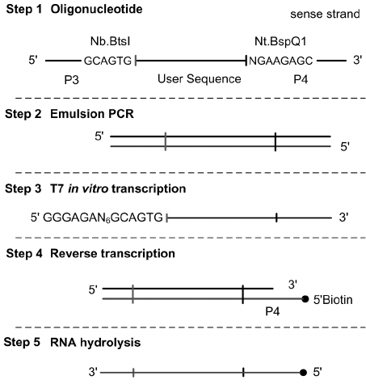
Enzymatic synthesis
ssDNA Synthesis Based on Transcription and Reverse Transcription
In vitro transcription and reverse transcription (ivTRT) is a three-step method, which involves preparation of dsDNA templates, transcription of RNA from the dsDNA, and preparation of ssDNA from the RNA.
The ivTRT method can be used to synthesize 0.5-2 kb ssDNA. The use of the nuclease in this method will limit its yield and will require a high quality DNA template..

Slide 15
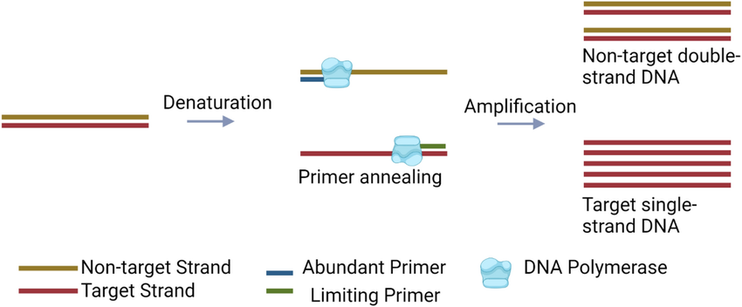
Enzymatic synthesis
Asymmetric PCR (aPCR)-
In the aPCR reaction system, there are two kinds of amplification primers with different concentrations, which go through two amplification stages to produce the required ssDNA.
The first stage is the exponential amplification of the dsDNA template, and the second stage is the linear amplification of ssDNA.
aPCR easily produces non-specific amplification and requires a lot of experiments to optimize reaction conditions, it has been successfully utilized to generate ssDNA sequences ranging from hundreds to thousands of nucleotides.

Slide 16
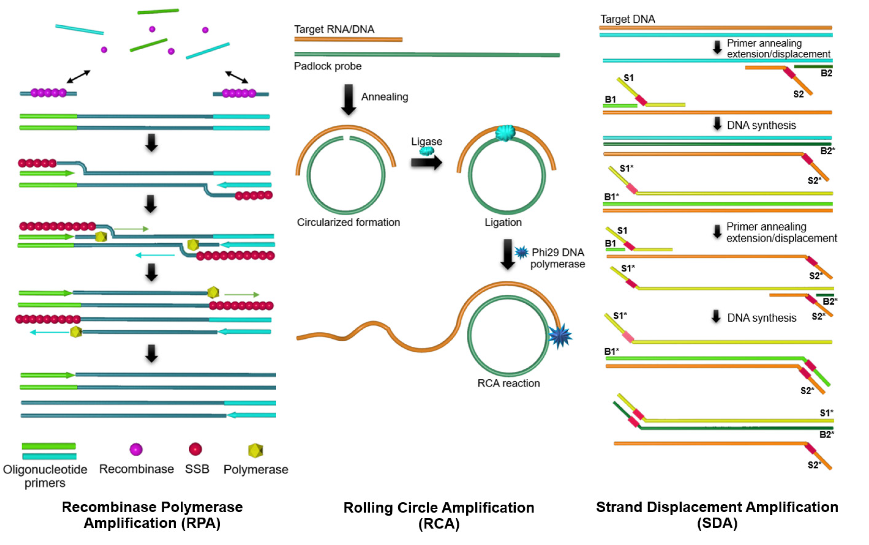
Enzymatic synthesis
Isothermal Amplification of ssDNA
Isothermal amplification technology for ssDNA production depends on enzyme activity or designed primers to avoid thermal denaturation of dsDNA template, including primer exchange reaction, rolling circle amplification, etc.
The difference between different isothermal amplification techniques lies in the use of different amplification initiation methods. Therefore, the initiation step is also a key factor limiting the speed and efficiency of the isothermal reaction.

Slide 17
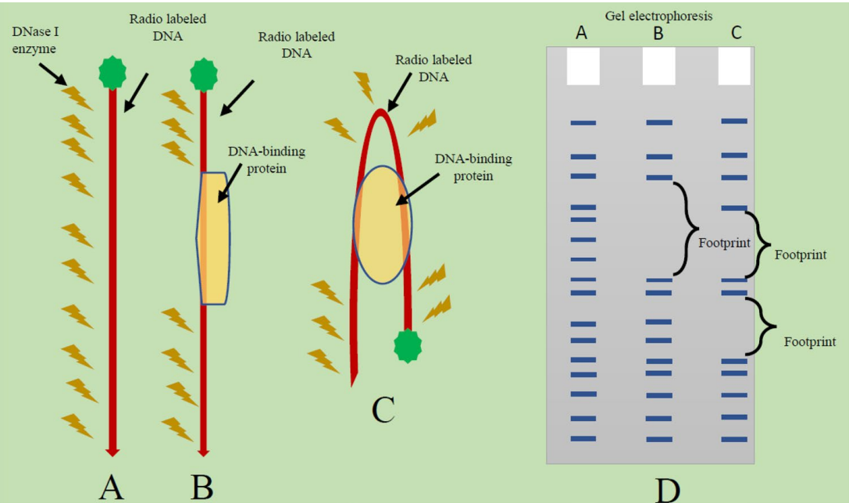
Diagram: DNAse 1 footprinting to confirm the protein- DNA interaction

Slide 18
DNA synthesis
&
Genome Sequencing

Slide 19
Q How do you read sequence in Maxam Gilbert method?

Slide 20
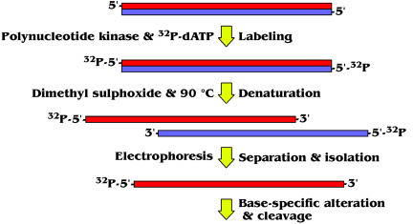
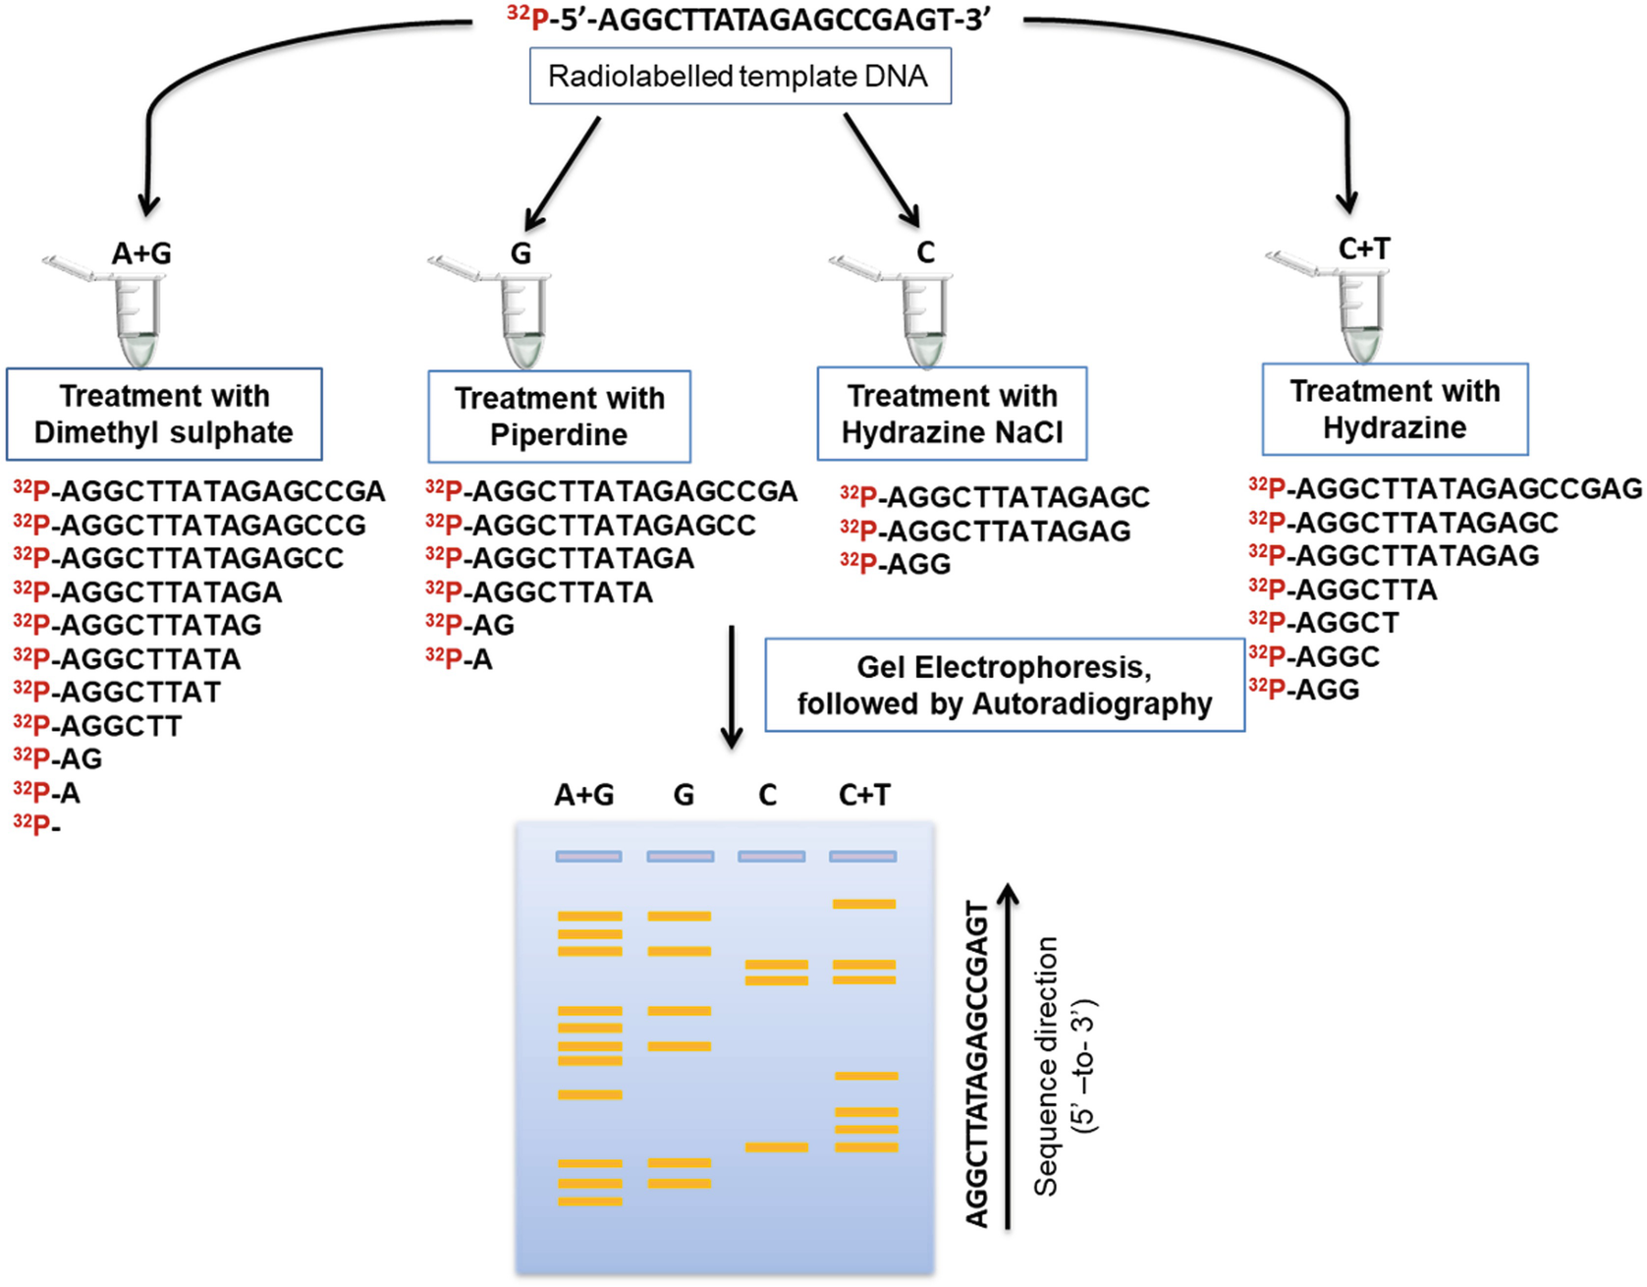
First generation sequencing
Maxam- Gilbert Sequencing:

Slide 21
First generation sequencing
Maxam- Gilbert Sequencing:
Allan Maxam and Walter Gilbert developed a method for sequencing single-stranded DNA by a two-step catalytic process involving piperidine and two chemicals that selectively attack purines and pyrimidines.
Purines react with dimethyl sulfate and pyrimidines react with hydrazine in such a way so as to break the glycoside bond between the ribose sugar and the base.
Dimethyl sulfate and piperidine alone selectively cleave guanine nucleotides but dimethyl sulfate and piperidine in formic acid cleave both guanine and adenine nucleotides.
Similarly, hydrazine and piperidine cleave both thymine and cytosine nucleotides, whereas hydrazine and piperidine in 1.5 M NaCl only cleave cytosine nucleotides.
The dark autoradiography bands on the film represent the 50 to 30 DNA sequence when read from bottom to top.
Bases | Bases | Outcome
A | A+G | G
____ | A+G | A
C | C+T | C
_____ | C+T | T

Slide 22
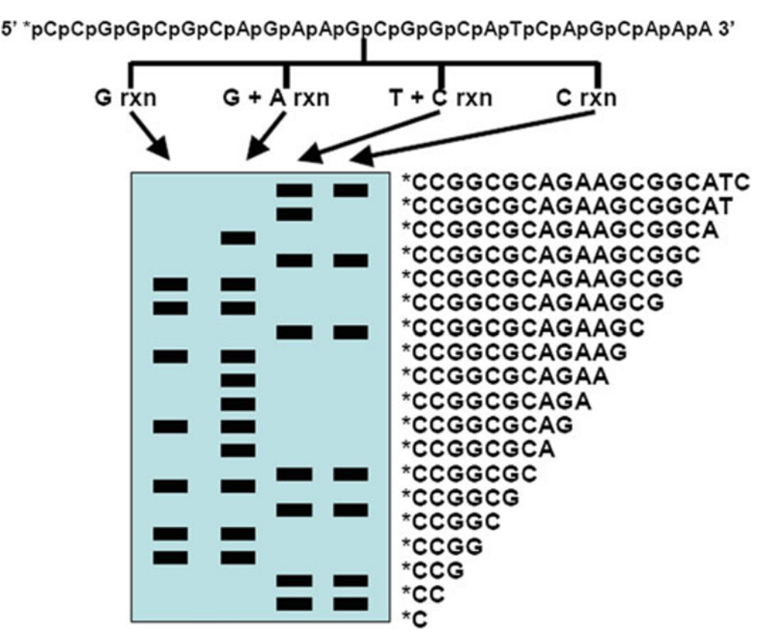
First generation sequencing
Maxam- Gilbert Sequencing:

Slide 23
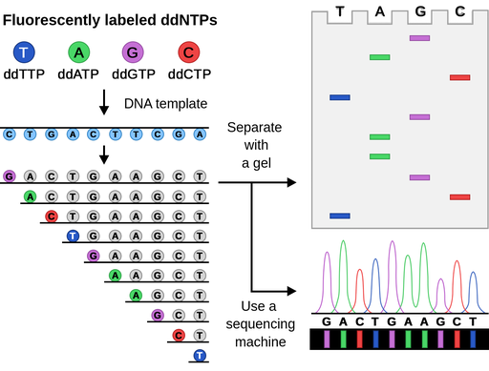
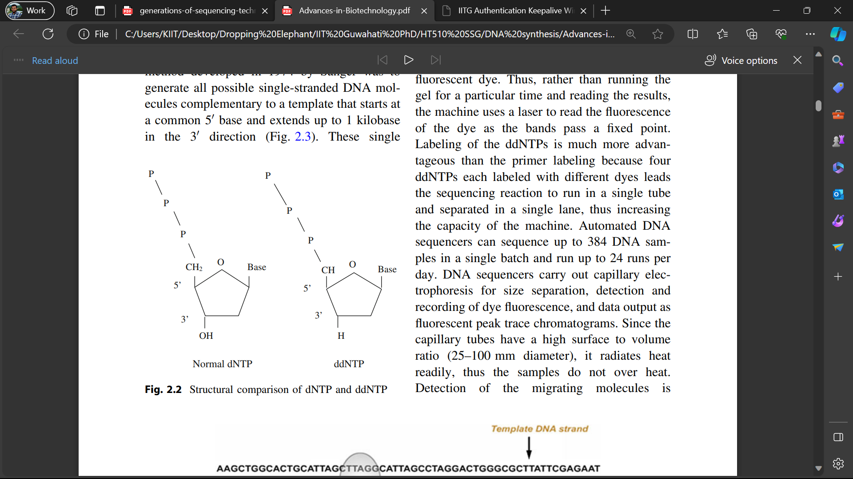
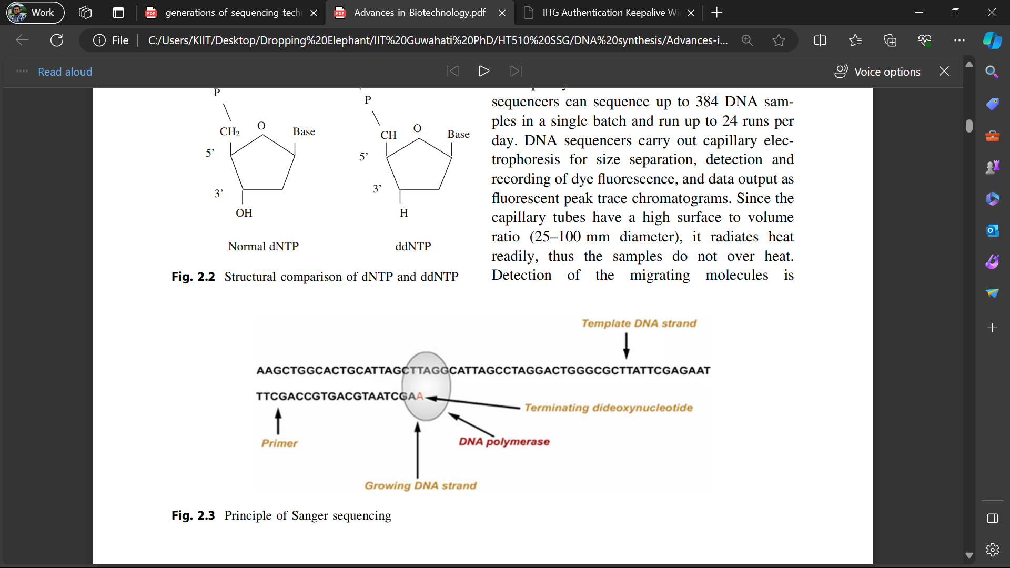
First generation sequencing
Sanger Sequencing:

Slide 24
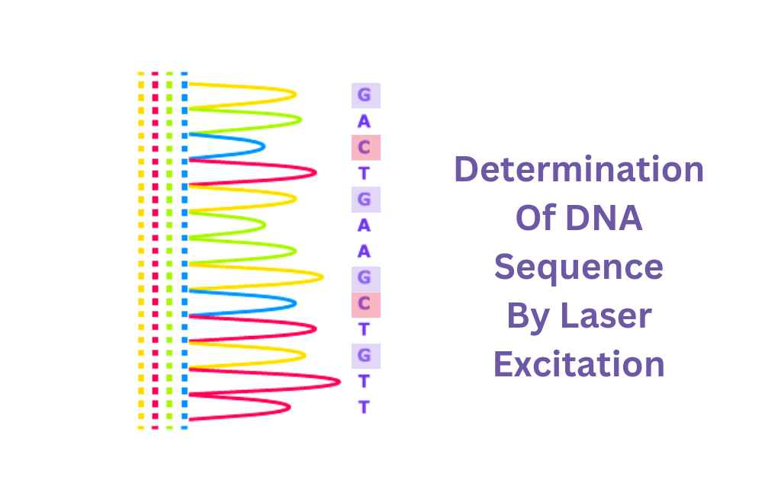
First generation sequencing
Sanger Sequencing:
Sanger Sequencing is known as the chain termination method or the dideoxy-nucleotide (ddNTPs) method or the sequencing by synthesis method.
Sequencing is made using chemically modified nucleotides called dideoxy-nucleotides (ddNTPs). These dNTPs are marked for each DNA bases by ddG, ddA, ddT, and ddC.
The dideoxy-nucleotides are used for pausing further dNTPs addition are used for stoppage of elongation of nucleotide, once incorporated into the DNA strand they prevent the further elongation and the elongation is complete.
Thee fragments are separated according to their size using gel slab where the resultant bands corresponding to DNA fragments can be visualized by an imaging system (X-ray or UV light).

Slide 25
Q How do you read the sequence in Sanger method?

Slide 26
Second generation sequencing
Illumina/ Solexa sequencing
Roche Pyrosequencing
Ion Torrent sequencing

Slide 27
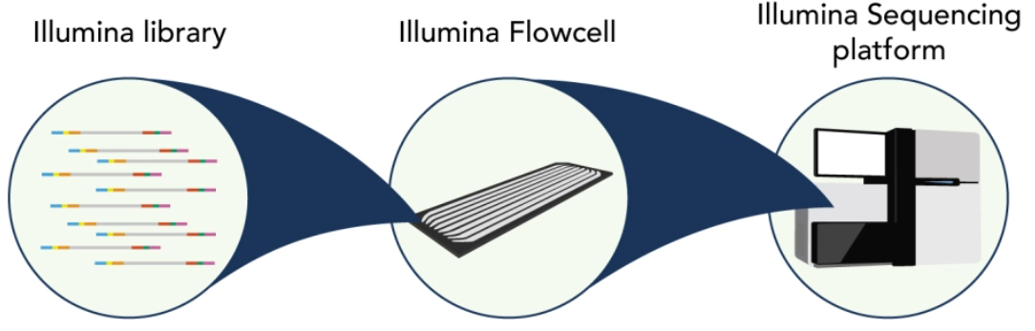
Illumina sequencing
https://www.youtube.com/watch?v=fCd6B5HRaZ8

Slide 28
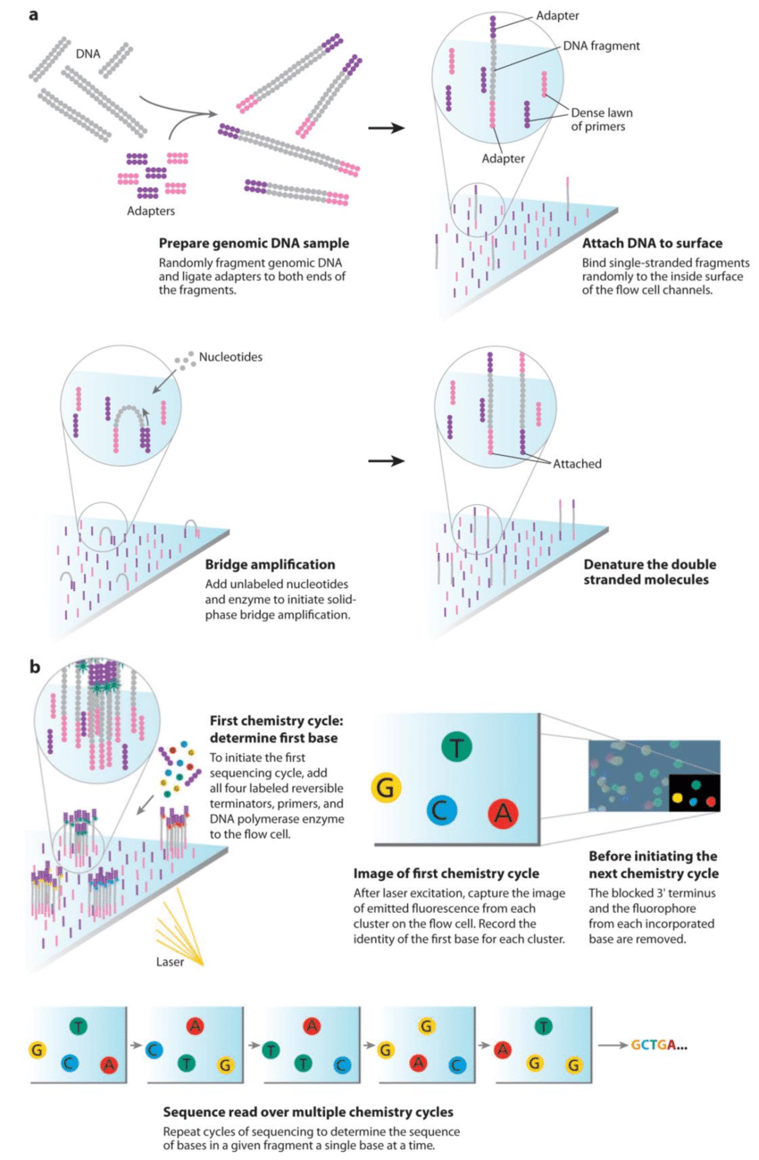
Illumina sequencing

Slide 29
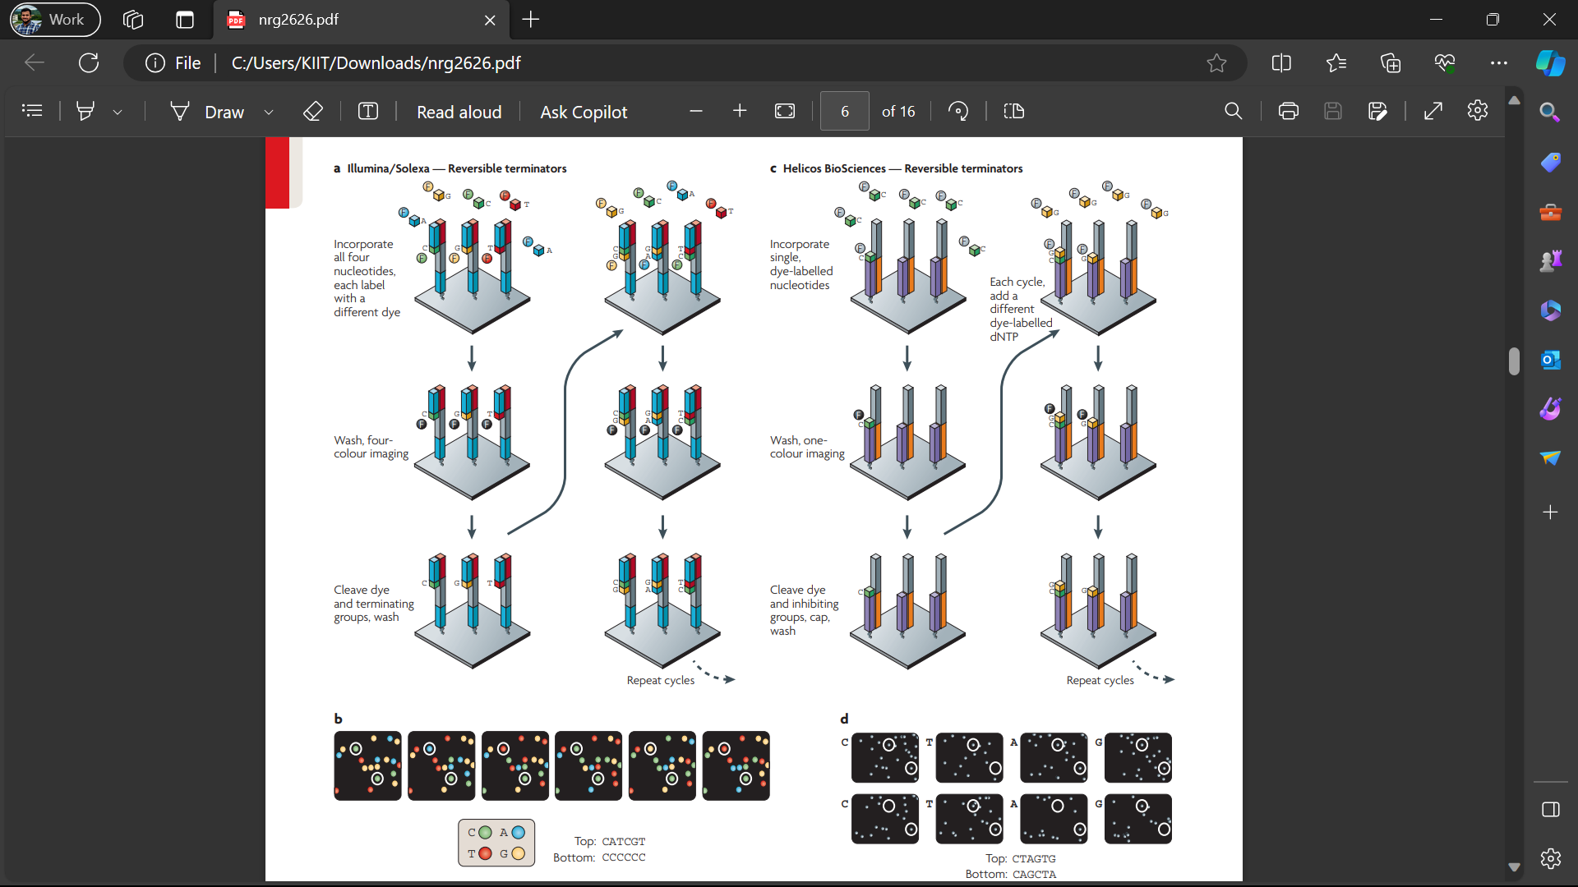
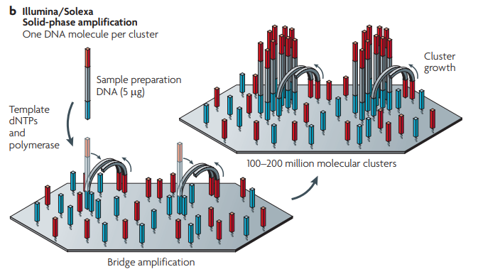
Illumina sequencing

Slide 30
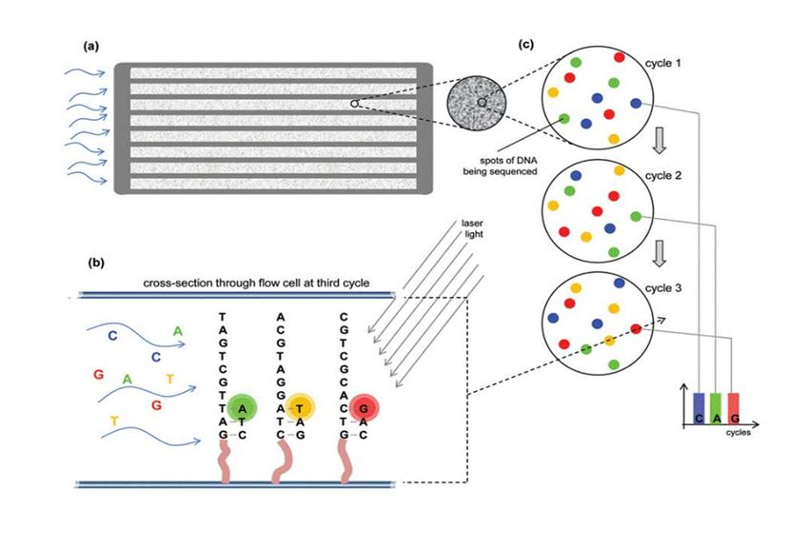
Illumina sequencing
Base Calling

Slide 31
THANK YOU

